Slide 1
Vue.js is Simple
And so can you!

Slide 2
Who am I?
My name is Marc Brosey.
I started my full-time professional development career in 2008.
Most of that time I’ve been a back-end developer.
I’ve spent my time closer to the database and further away from the UI.
I went from primarily writing code in VB6, to VB.NET, to C#.
I’ve used more SQL than HTML markup during that time.

Slide 3
How well do you know Javascript?
I kept getting asked this question in job interviews.
I’ve been using Javascript since 1998.
I’ve got a big, thick Javascript book entitled Javascript: Unleashed by Sams Publishing. It covers Javascript 2.0!
Yeah man, I know how to manipulate the DOM. Now hire me to do C#.
Do I know what a promise is? Yeah, I promise I know Javascript, now let me work on your C# project.
I used to be one of these guys: “People who write Javascript or Python are just playing around, those who write code in a real language that compiles down to some kind of byte-code are ‘real developers.’”

Slide 4
Ugh, Browser UI? Do I have to?
Why can’t we just create a Win Forms desktop app with a direct connection to the server?
I just learned how to get ActiveX controls working in the browser in ASP classic, why do we have to use Web Forms?
I just learned Web Forms, why do we have to move to ASP.NET MVC and use JQuery?
I just learned JQuery, why do you want me to learn Angular?
What Angular should I learn, version 1 or version 2? Or, hold on, wait!?! How many distinct versions are there of this thing?
I’m trying to learn Angular, what is this thing called Node, what is NPM, and all these other things I’ve never heard of?

Slide 5
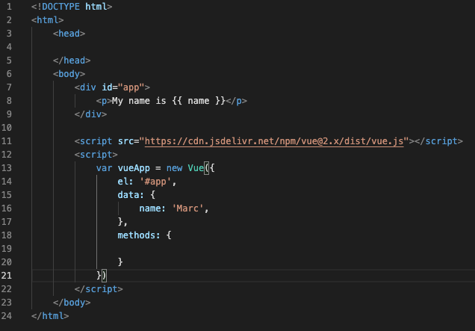
Vue.js is Simple!

Slide 6
The Anatomy of a Vue App
Data – This is where you define and set the initial value for all your variables.
Methods – This is where you define your functions to use.
Created – Function that is run when Vue app starts.
Mounted – Function that is run when Vue app is done loading.
Watch – List variables to watch for changes, then run a function or do something when variable changes.
Computed – Ok, this one is a little more advanced, as we’ll see, but still simple!

Slide 7
Vue.js is an easy-going honey badger.
What happens if I run two or more Vue.js apps on the same web page?
It’s cool. Vue apps work just fine along-side other Vue apps or other Javascript libraries.
Vue apps can call other Vue apps directly, or broadcast and subscribe to events.
Internal Vue variables and methods are accessed using “this.”
External Javascript variables can be accessed using “window.”

Slide 8
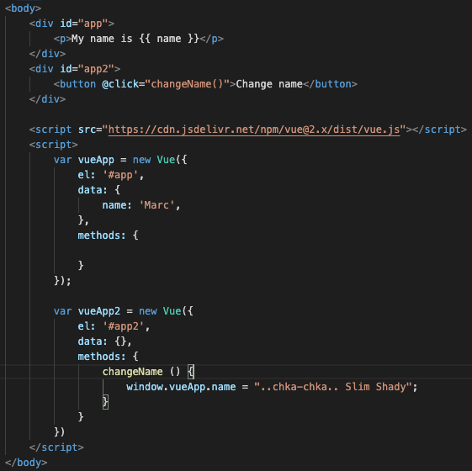
This is totally fine.

Slide 9
Simple UI/UX
These Vue apps work so well together, they literally finish each other’s sentences!
This means you can run a Vue app along-side your existing legacy website and Javascript libraries and not have to worry about it interfering with anything.
It’s nice that Vue is so simple, Marc, or Slim Shady, or whoever you are, but I need simple UI/UX, not just simple Javascript variable and method control.
Enter Vuetify, a collection of pre-built UI/UX Vue Components.
Help! I’m a back-end developer. How do I make a data table?
https://vuetifyjs.com/en/components/data-tables/
With Vuetify, you don’t even have to try.

Slide 10
Vue and Vuetify - Peas and Carrots
Vue and Vuetify work great together, provided they are the same version.
Do not cross the versions. Vuetify 2 cannot be used with Vue 3.
Vuetify 2 works with Vue 2.
Vuetify 3 works with Vue 3.

Slide 11
Vue Inception
I feel like the greatest test of any software development technology is in its flexibility and ability to be dynamic.
We’ve already seen that two Vue apps can run side by side in the same web page with no issue.
Can we run a Vue app inside of a Vue app in order to build a Vue app with a Vue app?
Since we have such robust documentation from the Vuetify website, could we create a Vue app that would write our components for us so we didn’t have to take the extra step of looking up the correct code, copying it, and pasting it into our site?

Slide 12
It’s Demo Time!

Slide 13
Q & A
Demo source code and slide deck:
https://github.com/Marc-Brosey/VuetifyUIBuilder
Thank you KnoxDevs for hosting this event.
Find me on KnoxDevs Slack, @marc.brosey.

Slide 14
You’re Welcome

